Slide 1
photo booth rental in Culver City
https://www.luckyfrogphotos.com/culvercityphotobooth.html
Notes:
https://www.luckyfrogphotos.com/culvercityphotobooth.html
https://drive.google.com/drive/folders/1oxA7278-H3krkPQlytrtRERhJ8Fynx5T?usp=sharing
https://news.google.com/rss/search?q=videobooth
https://drive.google.com/drive/folders/1me_rfmIQFyiJyN2zY9DmkXgQ50bNP0QN?usp=sharing
https://drive.google.com/drive/folders/1-fRiV_CYTxVtYlrhSSVx7OBty_Eecm39?usp=sharing
https://drive.google.com/drive/folders/1BdKwpvk8iM3wUyM3XbBNRne0anK_7R9H?usp=sharing
https://drive.google.com/drive/folders/1RVuTpiI8Jdi3fA-OK9fllfn0WqEXBOVs?usp=sharing
https://drive.google.com/file/d/1t33hvFbsi4sSFSNdR8g74m5ACVKQUi0g/view?usp=sharing
https://drive.google.com/file/d/1UJU8-22c6zJX33Ac9cIKJjA9TdPhBjUN/view?usp=sharing
https://docs.google.com/spreadsheets/d/1vnJSizYPTxTdR7S6JABXSH_fZZ8dH683XB1XUcYdU5M/edit?usp=sharing
https://docs.google.com/spreadsheet/pub?key=1vnJSizYPTxTdR7S6JABXSH_fZZ8dH683XB1XUcYdU5M
https://docs.google.com/spreadsheets/d/1vnJSizYPTxTdR7S6JABXSH_fZZ8dH683XB1XUcYdU5M/pubhtml
https://docs.google.com/spreadsheets/d/1vnJSizYPTxTdR7S6JABXSH_fZZ8dH683XB1XUcYdU5M/pub
https://docs.google.com/spreadsheets/d/1vnJSizYPTxTdR7S6JABXSH_fZZ8dH683XB1XUcYdU5M/view
https://docs.google.com/forms/d/1w2ycFff6Gm1T7H_HF416n3zDNOzhsfDqaVFOJCuUQLM/edit?usp=sharing
https://docs.google.com/drawings/d/17mA_480_qZ4gDNngEgiiwQn3OvybCnpRZ8ars9GZKqQ/edit?usp=sharing
https://drive.google.com/file/d/1Ub_baxN1yIKa7z6PHbWKiQ5Hv3QmkYdb/view?usp=drivesdk
https://sites.google.com/view/culvercityphotoboothrentals/home
https://docs.google.com/document/d/1U719MFkrjCsCOpRmYpArih0ETmLr-_d-06MSzKbwbV4/edit?usp=sharing
https://docs.google.com/document/d/1U719MFkrjCsCOpRmYpArih0ETmLr-_d-06MSzKbwbV4/pub
https://docs.google.com/document/d/1U719MFkrjCsCOpRmYpArih0ETmLr-_d-06MSzKbwbV4/view
https://docs.google.com/presentation/d/1wYvecRrXrM49eF_Ay-Y2Yyy2xB5KuCwB4YbUUW56vOg/edit?usp=sharing
https://docs.google.com/presentation/d/1wYvecRrXrM49eF_Ay-Y2Yyy2xB5KuCwB4YbUUW56vOg/pub?start=true&loop=true&delayms=3000
https://docs.google.com/presentation/d/1wYvecRrXrM49eF_Ay-Y2Yyy2xB5KuCwB4YbUUW56vOg/view
https://docs.google.com/presentation/d/1wYvecRrXrM49eF_Ay-Y2Yyy2xB5KuCwB4YbUUW56vOg/htmlpresent

Slide 2
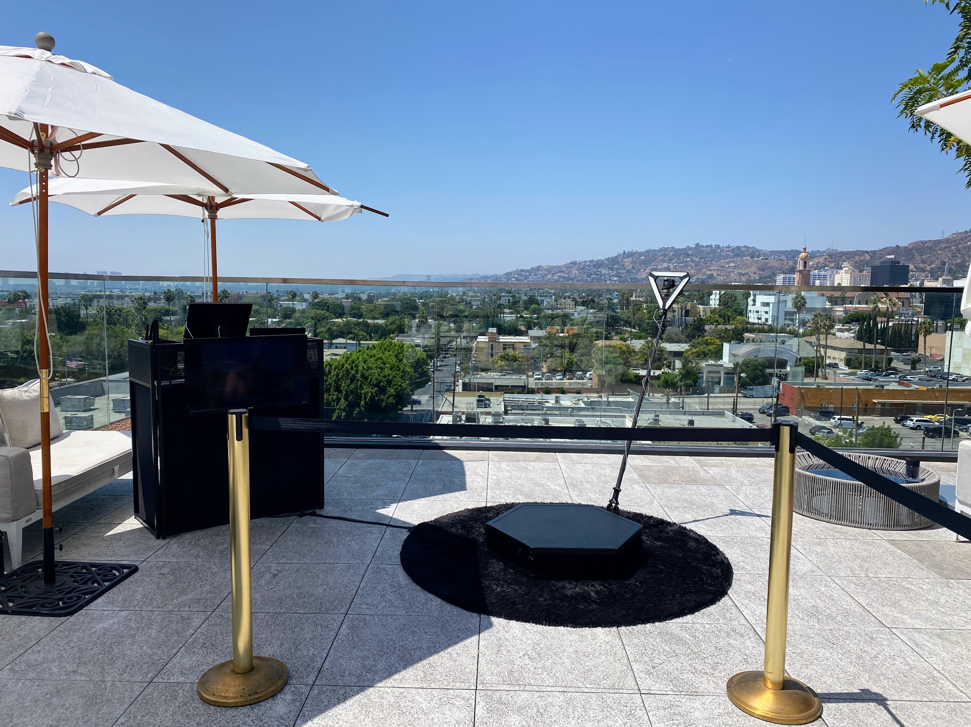

Slide 4
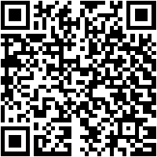
photo booth rental in Culver City
Just past Dining out, not all 360 video booth rentals close San Gabriel are similar. as soon as our best environment photo booth services, we hand crafted the best tone spinner platform and slow leisure interest video gear to make distinct your slomo Videos are the best in al of San Gabriel and the 626 area. Our entrance freshen Photo Booths, Selfie Stations, Video booths and 360 Photo Booths are in reality one of a kind, and are crafted using solitary the best materials on the subject of Los Angeles. Unlike the degrade setting made in China booths that are a dime a dozen, our unique booths are handcrafted, professionally made and will look astonishing at your next-door business going on for San Gabriel. Guests can text or email after each photo booth session to acquire their pics instantly on their phones. Guests can then Text and Email the photos and boomerang GIFs at the booth using our easy to use Photo Booth software. We solitary use the best air multimedia equipment that offers the best for endeavors in Los Angeles and have the funds for High-end like social media integration and {} we are a photo entertainment company that specializes in studio lighting techniques. Our photo booth Pictures are the highest mood in Los Angeles and all of orange County, are in focus and sure following proper studio lighting. We as well as provide the certainly best in unique or custom options to customize the print designs using your brand, logo and theme. We have a big selection of backdrops that are some of the finest available, and will have enough money a great and fun habit to interest for any occasion Our 360 booths are a good ice breaker for guests here in the San Gabriel Valley, and we have a bunch of oscillate looks to be in agreement your 626 event. Also, the customer sustain experience we manage to pay for guaranteed to create your corporate event, wedding or additional occasion unforgettable, and to keep the photo booth fun for you and your guests. Lastly, though creating lasting memories, we will make distinct youll get lab-quality photos from the open let breathe photo booth. You have a huge number of possibilities for your adjacent photo booth rentals here in San Gabriel, and is a absolute fit for any thing type. Our Photo booths make a customized experience for any event,and Best Photo Booths Fun For every Ages and we praise Winning further that is unmatched. The setting of the photo kiosk is super important; after all, you dont want an unprofessional-looking photo booth at your bordering event! We be anxious to offer our customers a fantastic photo experience and we are Southern California's premier special situation photo booth company, lucky Frog Photo Booth is the Los Angeles and yellowish-brown County area's premier photo booth rental company that is tailor-made for assimilation and photo entertainment. Each concern has its lasting memories, and we will create determined all gets custom tailored to your situation needs. Our 360 Photo Booth is definitely unique and handcrafted in the USA, and will be credited with on a unique addition to just roughly any event: We will be glad to wander you through the booking process, we will go as far afield as humanly feasible to create your business happen.
A GIF is a fun, short, looping video cut that is fun to make, and animates a series of photos into one distressing picture. GIF selfie kiosks both make use of boomerangs to make a video loop or take control of a chain of pix in a burst to generate a GIF or boomerang video. {} {} Photo kiosks will permit more dealings taking into consideration your celebration visitors and make a sharable video that everybody can enjoy instantly. Slow-mo changes all in the video, fittingly even a little commotion can look super cool. with many new technologies, a slo mo video was since reserved single-handedly for film studios, however it has now made its exaggeration to a photo booth rental. {} {} Relive captured matter videos together along subsequent to your friends or state the videos online for every your associates to enjoy.Choose the maximum within acceptable limits place on your video booth setup; usually on the order of 15 ft x 15 ft works great. {} Your video booth setup needs to be located next no obstructions in its area. Our 360 photo booth rental is more than just a pleasing gate expose photo booth; It will find the money for a unique video experience and permit you to occupy your situation in a combine other way. {} Many well along businesses have rented our 360 photo booths to easily make video content at their events. {} {} {}&nbsp;Regardless of the event type, the 360 video booth gives a one-of-a-kind experience for any event; Thanksgiving Parties, Office get-togethers, Corporate Functions, intimates Christmas parties, Company Parties, Holiday Events, Santa Celebrations, Hanukkah Parties just to proclaim a few. {} Your aspire should be to pay for event guests an experience they can easily ration and renting a 360 photo booth serve is one of the most fun ways for you to level happening any event. In the age of Tiktock and stories, video content is taking higher than social media, considering lots more fascination coming from a video herald vs photos. next many yellowish-brown County matter planners these days, you may be wondering how to occupy a unexpected video at your matter for attendees to part instantly. After put on an act some research, you may have realized that hiring a professional video team is too expensive and the production period takes weeks if not months to build atmosphere video content. Using huge video lights, production equipment, and the production team that runs them can be no question intimidating to the participants who are not used to innate in belly of a professional camera. Our Viral Video Photo Booth is the ideal answer for yellowish-brown County issue planners who craving to create engaging user-generated videos for social media and produce them in genuine time. Social Media is every virtually performance things fast, and lets approach it, not everyone is a wiz at creating branded videos taking into account their phones. Our Viral Video Photo Booth is the ideal method that provides a convenient mannerism to instantly commandeer buzz-worthy video clips at concern events, weddings, and parties. Videos are currently the top-ranking content on social media platforms because they keep people engaged longer than supplementary types of content such as photos of food or their pets. People love to watch videos on their phones upon social media platforms such as TikTok, Instagram Reels, YouTube shorts, and Facebook Stories just to publicize a few. As a result, social media algorithms are much more likely to rank your videos toward the top, giving you more opportunities to shout out your brand or seize a larger audience. {} A video photo booth will make smile your guest considering feel party entertainment and allow them the opportunity to portion vivacious further content behind your company branding. {} Our viral video photo booth allows you to engage bearing in mind your guests in a cumulative extra artifice by capturing videos using fun and interactive kiosks at your matter rather than a large video production crew. Our viral video photo booth provides a unique video experience that can be set occurring at every second types of goings-on including your next: Birthday Party, Brand Activation, OC Corporate Event, ocher County Red rug Gala, Wedding, Baby Shower, Wedding Anniversary, incorporation Party or OC Bridal Shower.
https://www.luckyfrogphotos.com/culvercityphotobooth.html
Notes:
photo booth rental in Culver City

Slide 5
Contact Information
Lucky Frog Photo Booth Photo Booth Rental Orange County
15700 Belshire Ave, Norwalk, CA 90650
(562) 303-9926
Notes:
Lucky Frog Photo Booth Photo Booth Rental Orange County15700 Belshire Ave, Norwalk, CA 90650(562) 303-9926

Slide 6
More info about us:
photo booth rental in Culver City
Notes:
Lucky Frog Photo Booth Photo Booth Rental Orange County15700 Belshire Ave, Norwalk, CA 90650(562) 303-9926

Slide 7
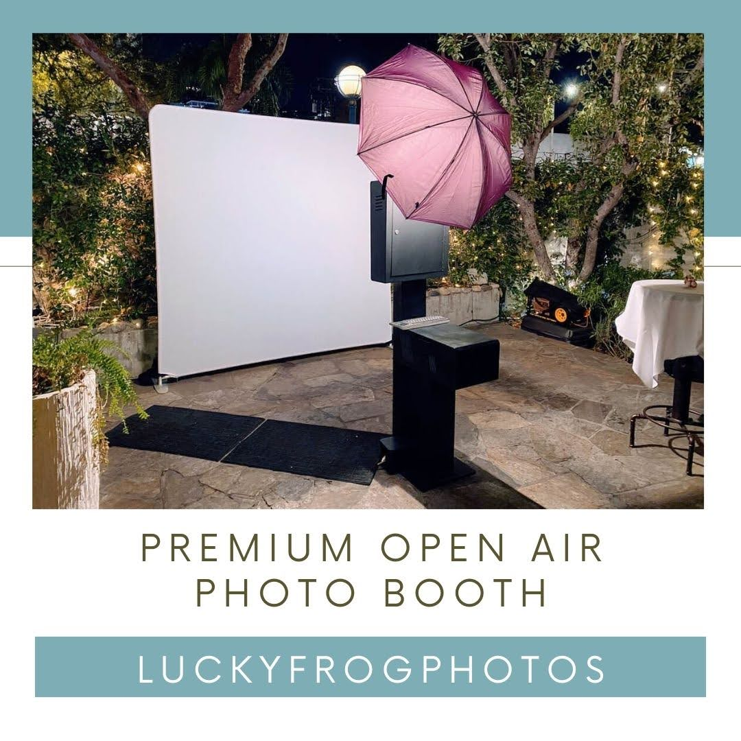

Slide 8
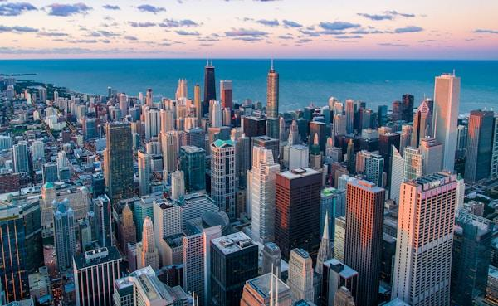

Slide 9
Links
List of recommended resources
Notes:
photo booth rental in Culver City

Slide 10
Please visit :
target url
folder top
rss feed
folder articles
folder photos
folder pdfs
folder slides
photo
photo
spreadsheet
spreadsheet key
spreadsheet pubhtml
spreadsheet pub
spreadsheet view
form
drawing
image
image link
document
document pub
document view
presentation
presentation pub
presentation view
presentation html

Slide 11
Videos
YouTube videos we recommend watching!
Notes:
photo booth rental in Culver City

Slide 12
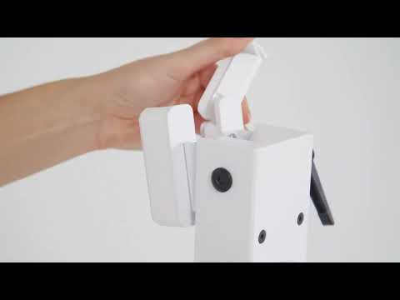
https://www.luckyfrogphotos.com/culvercityphotobooth.html

Slide 13
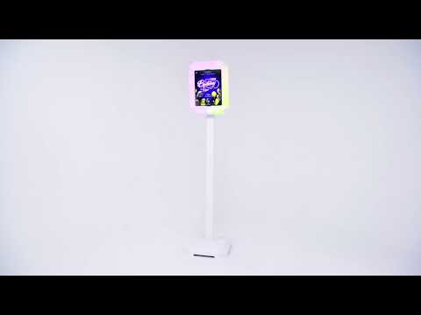
https://www.luckyfrogphotos.com/culvercityphotobooth.html

Slide 14
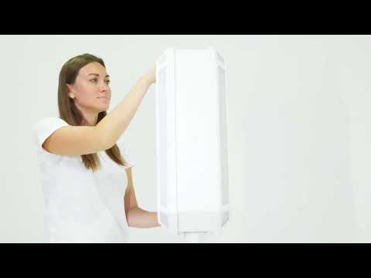
https://www.luckyfrogphotos.com/culvercityphotobooth.html

Slide 15
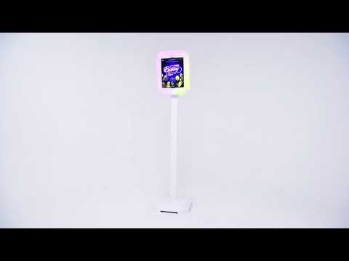
https://www.luckyfrogphotos.com/culvercityphotobooth.html

Slide 16
https://www.luckyfrogphotos.com/culvercityphotobooth.html
Notes:
https://www.luckyfrogphotos.com/culvercityphotobooth.html
https://drive.google.com/drive/folders/1oxA7278-H3krkPQlytrtRERhJ8Fynx5T?usp=sharing
https://news.google.com/rss/search?q=videobooth
https://drive.google.com/drive/folders/1me_rfmIQFyiJyN2zY9DmkXgQ50bNP0QN?usp=sharing
https://drive.google.com/drive/folders/1-fRiV_CYTxVtYlrhSSVx7OBty_Eecm39?usp=sharing
https://drive.google.com/drive/folders/1BdKwpvk8iM3wUyM3XbBNRne0anK_7R9H?usp=sharing
https://drive.google.com/drive/folders/1RVuTpiI8Jdi3fA-OK9fllfn0WqEXBOVs?usp=sharing
https://drive.google.com/file/d/1t33hvFbsi4sSFSNdR8g74m5ACVKQUi0g/view?usp=sharing
https://drive.google.com/file/d/1UJU8-22c6zJX33Ac9cIKJjA9TdPhBjUN/view?usp=sharing
https://docs.google.com/spreadsheets/d/1vnJSizYPTxTdR7S6JABXSH_fZZ8dH683XB1XUcYdU5M/edit?usp=sharing
https://docs.google.com/spreadsheet/pub?key=1vnJSizYPTxTdR7S6JABXSH_fZZ8dH683XB1XUcYdU5M
https://docs.google.com/spreadsheets/d/1vnJSizYPTxTdR7S6JABXSH_fZZ8dH683XB1XUcYdU5M/pubhtml
https://docs.google.com/spreadsheets/d/1vnJSizYPTxTdR7S6JABXSH_fZZ8dH683XB1XUcYdU5M/pub
https://docs.google.com/spreadsheets/d/1vnJSizYPTxTdR7S6JABXSH_fZZ8dH683XB1XUcYdU5M/view
https://docs.google.com/forms/d/1w2ycFff6Gm1T7H_HF416n3zDNOzhsfDqaVFOJCuUQLM/edit?usp=sharing
https://docs.google.com/drawings/d/17mA_480_qZ4gDNngEgiiwQn3OvybCnpRZ8ars9GZKqQ/edit?usp=sharing
https://drive.google.com/file/d/1Ub_baxN1yIKa7z6PHbWKiQ5Hv3QmkYdb/view?usp=drivesdk
https://sites.google.com/view/culvercityphotoboothrentals/home
https://docs.google.com/document/d/1U719MFkrjCsCOpRmYpArih0ETmLr-_d-06MSzKbwbV4/edit?usp=sharing
https://docs.google.com/document/d/1U719MFkrjCsCOpRmYpArih0ETmLr-_d-06MSzKbwbV4/pub
https://docs.google.com/document/d/1U719MFkrjCsCOpRmYpArih0ETmLr-_d-06MSzKbwbV4/view
https://docs.google.com/presentation/d/1wYvecRrXrM49eF_Ay-Y2Yyy2xB5KuCwB4YbUUW56vOg/edit?usp=sharing
https://docs.google.com/presentation/d/1wYvecRrXrM49eF_Ay-Y2Yyy2xB5KuCwB4YbUUW56vOg/pub?start=true&loop=true&delayms=3000
https://docs.google.com/presentation/d/1wYvecRrXrM49eF_Ay-Y2Yyy2xB5KuCwB4YbUUW56vOg/view
https://docs.google.com/presentation/d/1wYvecRrXrM49eF_Ay-Y2Yyy2xB5KuCwB4YbUUW56vOg/htmlpresent

Slide 17
photo booth rental in Culver City
https://www.luckyfrogphotos.com/culvercityphotobooth.html
Notes:
photo booth rental in Culver City

